Slide 1



Deepfake Detection for Ensuring Digital Integrity
Presentation by:
Aman Chauhan
Anupma Pandey
Barneet Singh
Megha

Slide 2

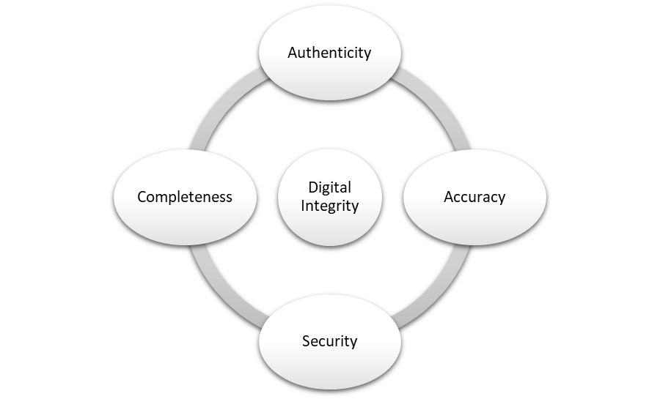


Slide 3
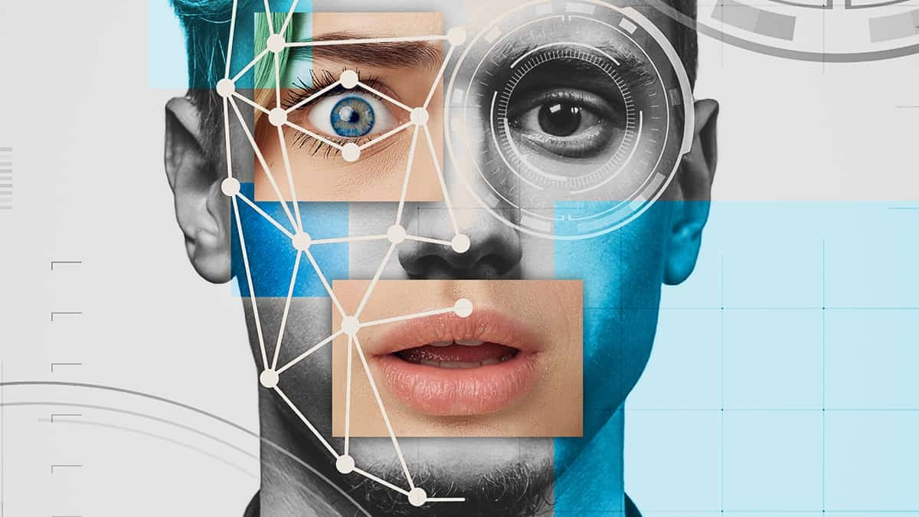
DeepFake
AI-generated media where faces, voices, or actions are manipulated to create realistic, but fake content.

Slide 4
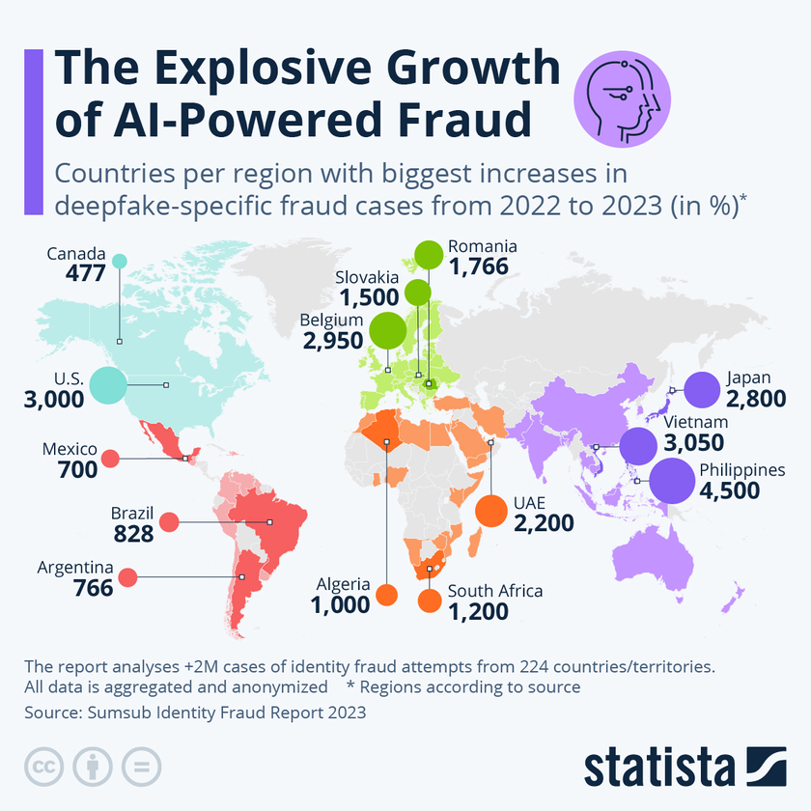
In financial year 2024, the Reserve Bank of India (RBI) reported bank frauds amounting to more than 139.3 billion Indian rupees

Slide 5


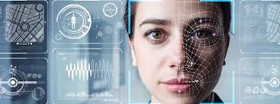
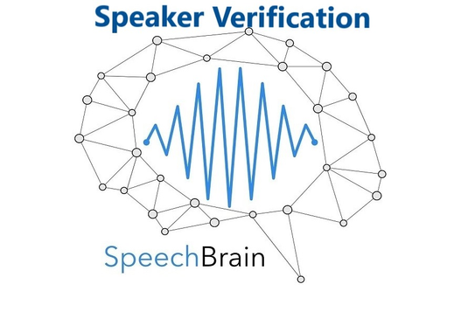
DeepFake Detection
Identity Verification
Deepfake genration models and other fraudster techniques surpassed all these securities

Slide 6

KYC via video calls, require customers to verify their identity in real time, but this method is time-consuming, time restricted and resource-intensive.
Identity Verification in Bank

Slide 7
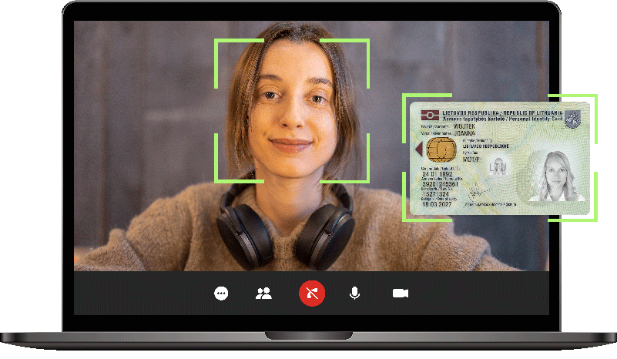


Modern Solution
Users are asked to record videos in real time, following specific instructions—such as speaking certain sentences or performing certain actions. This makes it harder for deepfake models to bypass because they cannot yet efficiently generate tailored, real-time responses.
The quick brown fox jumps over the lazy dog

Slide 8

Emerging Problem
No sooner in the future Deepfake generation models will become capable enough to generate tailored instruction based videos, in real quick time. This is an emerging challenge.
This poses a critical threat in sectors like banking, where scammers could use these deepfakes to impersonate trusted individuals to perform financial frauds

Slide 9
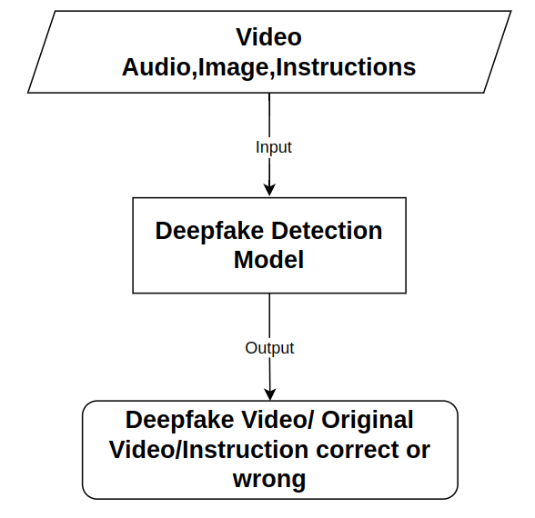

Slide 10
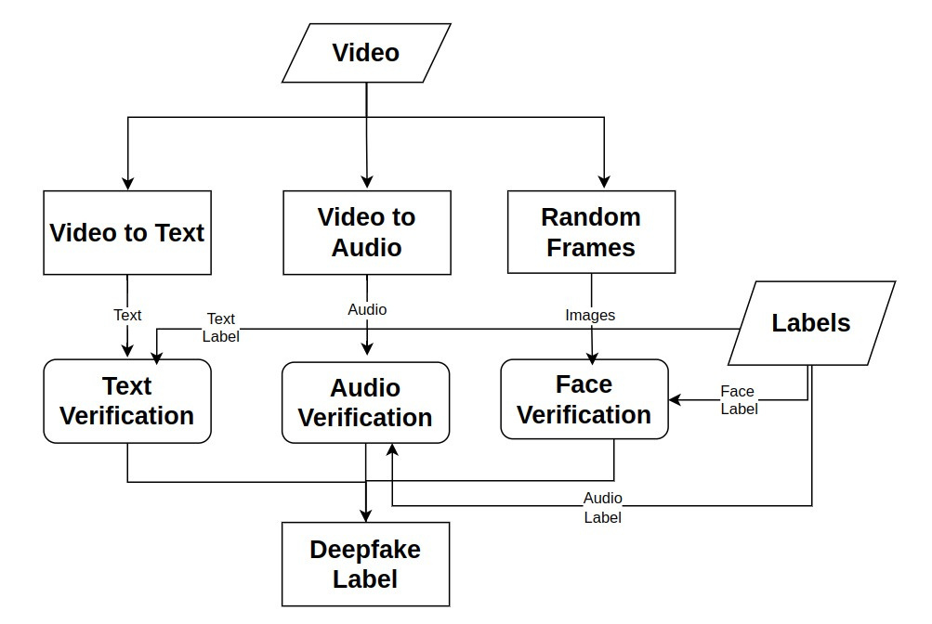
Our Solution
DeepFake Detection from Video

Slide 11


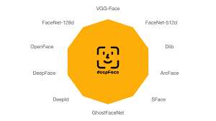


Tech Stack

Slide 12
Future Scope
Unified model for multi-modal detection
Facial movement recognition
Integration of temporal analysis

Slide 13

THANK YOU!

